Slide 1
Write the same title
That you used in the report
PDF Report Title
First Student Name
Second Student Name
Medellín, Date of the oral presentation
Write your names and the
Date of the oral presentation

Slide 2
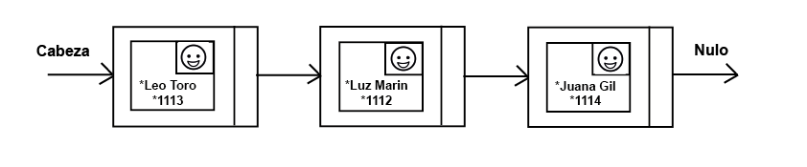
Conserven este título
Estructuras de Datos Diseñada
Inserten sus gráficas vectorizadas que explican su Estructura de Datos
Gráfico 1: Lista simplemente encadenada de personas. Una persona es una clase que contiene nombre, cédula y foto.
Escriban sus propias palabras para describir sus gráficas

Slide 3
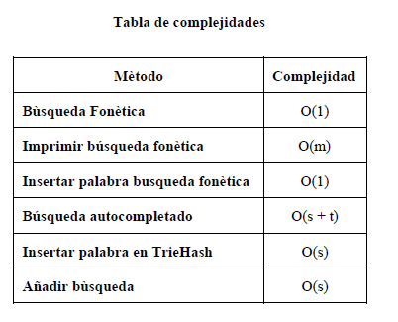
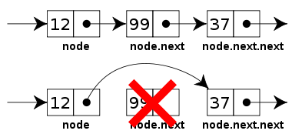
Data Structure Operations
Keep this title
Gráfico 2: Operación de borrado
de una estructura de datos
Tabla 1: Complejidad de las operaciones
de la estructura de datos
Include your own figures, tables and explanation

Slide 4
Design Criteria of the Data Structure
Keep this title
To solve the problem, we should used, extensively, the delete operation of the first and last element.
The delete operation in a Linked List, for the first and last element, has a time complexity of O(1).
The delete operation has a memory complexity of O(1).
The delete operation of a linked list is, therefore, efficient to solve the problem.
Include your own figures and
explanations

Slide 5
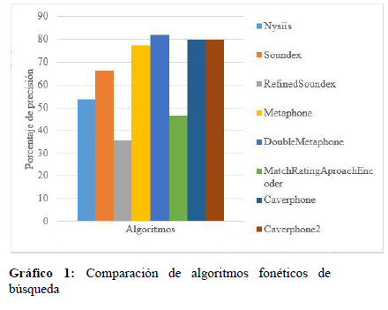
Time and Memory Consumption
Use this title
Include your own figures and explanations

Slide 6
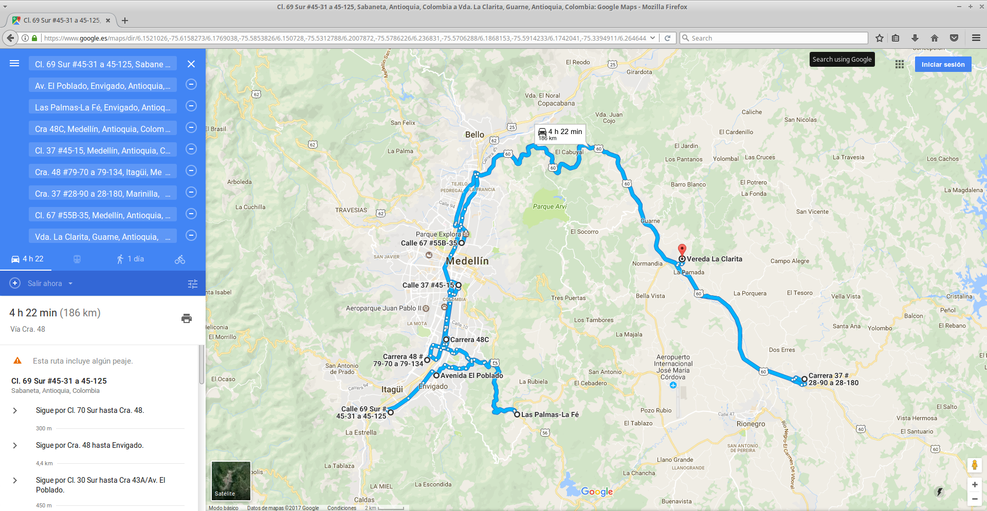
Implementation
Keep this title
Gráfico 4: Sistema de planificación óptima de domicilios
Include your own figures and explanations

Slide 7
Report in arXiv
Keep this title
C. Patiño-Forero, M. Agudelo-Toro, and M. Toro. Planning system for deliveries in Medellín. ArXiv e-prints, Nov. 2016. Available at: https://arxiv.org/abs/1611.04156
Insert the URL and information of your report accepted in arXiv.

